Slide 1
Math note 3.8-3.10, 4, 5 ridge regression kernel SVN Regression comparison

Slide 2
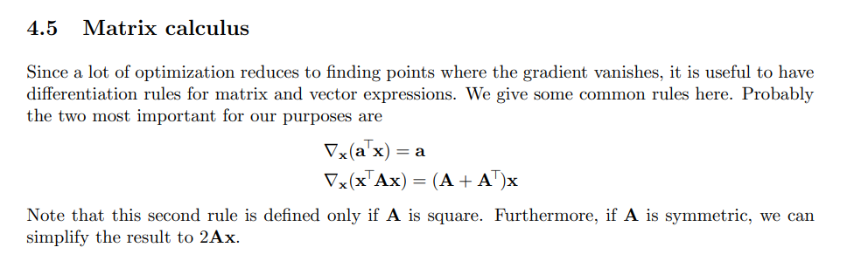
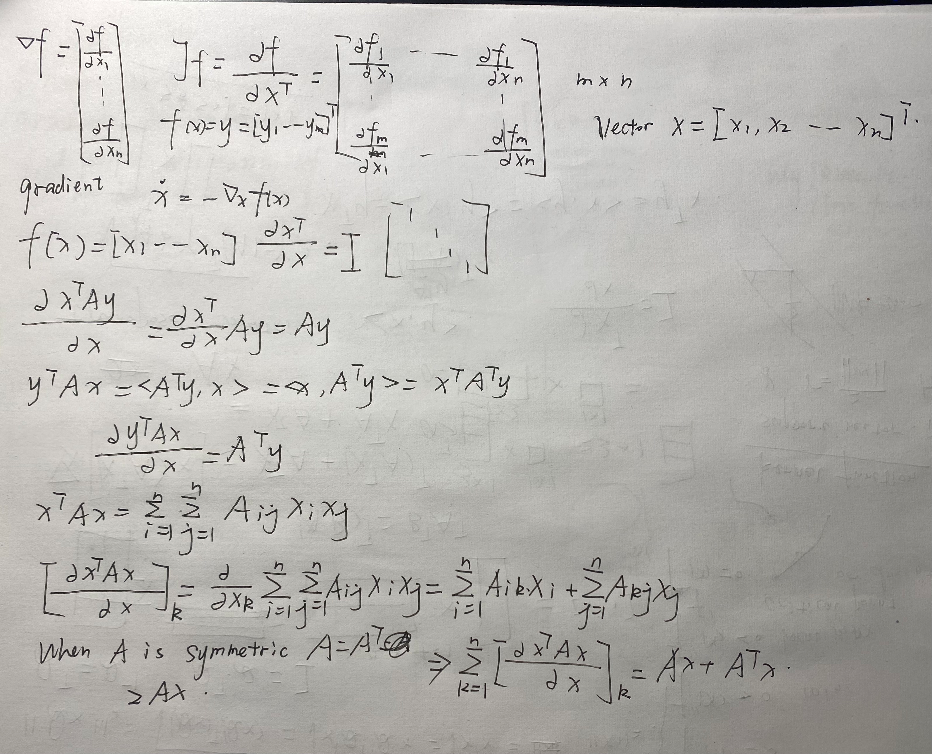

Slide 3
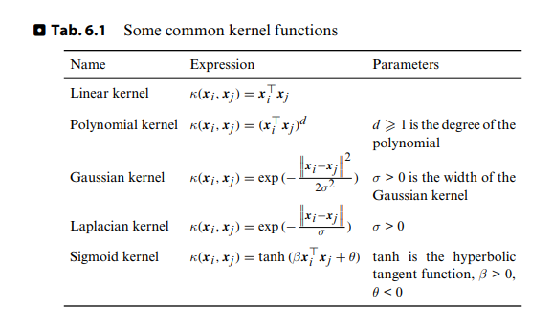
kernel SVM
The samples are mapped from low dimensional space (input space) to high dimensional space (feature space) for linear division.
Since the low-dimensional space cannot be linearly segmented, let's convert the sample to the high-dimensional space for linear segmentation.

Slide 4
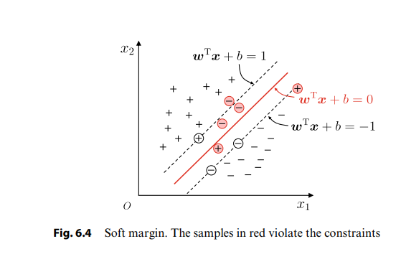
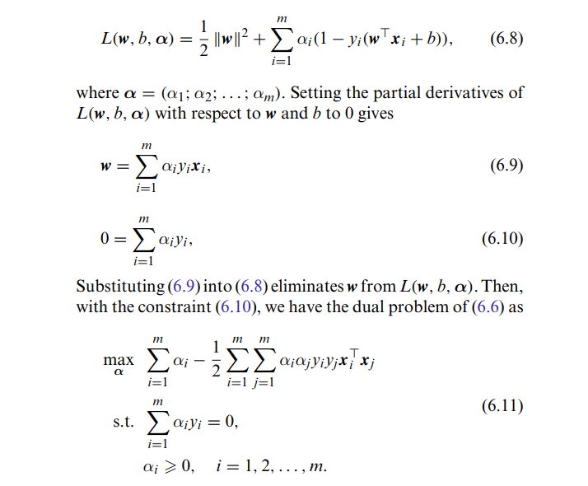
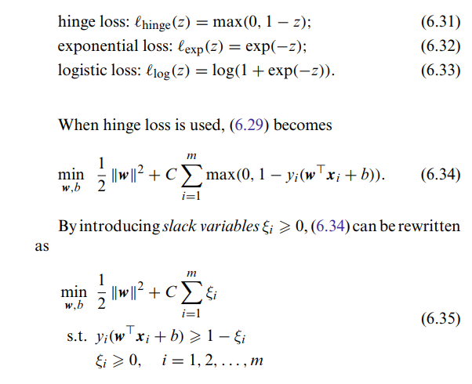
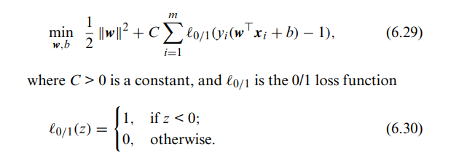

Slide 5
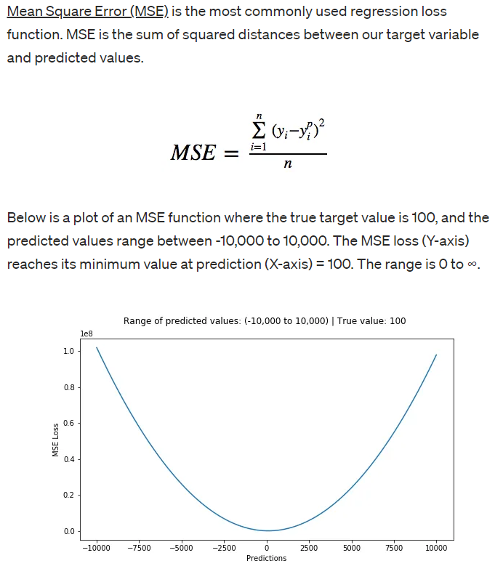
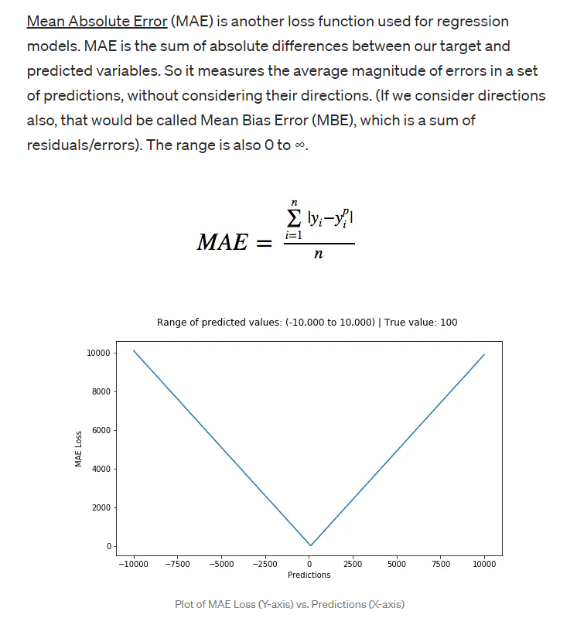
Why loss function should be like this? Why I use this kind of regression?
Least absolute deviations(L1) and Least square errors(L2) are the two standard loss functions, that decides what function should be minimized while learning from a dataset

Slide 6
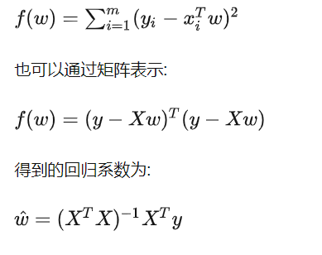
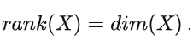
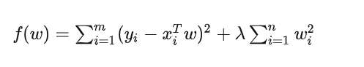
Ridge Regression
Least Squares(L2) outperform L1, when there are no outliers in the data and collinearity in data characteristics
penalty term:
Can do group selection
Cannot converge model coefficient to 0

Slide 7
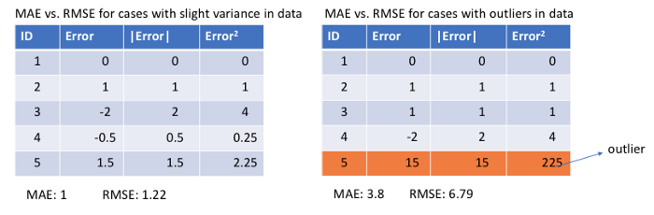
L1 loss function is more robust and is generally not affected by outliers. On the contrary L2 loss function will try to adjust the model according to these outlier values, even on the expense of other samples. Hence, L2 loss function is highly sensitive to outliers in the dataset.

Slide 8
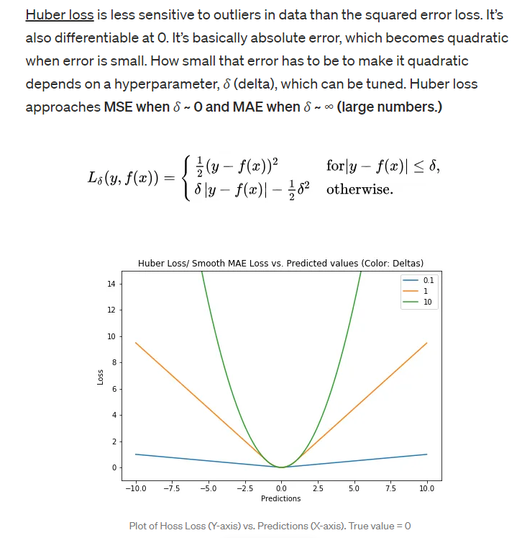

Slide 9
Selecting the best algorithm for regression problem
SVM vs. logistic regression
Logistic regression can only deal with two classification problems and must be linearly separable
There is no general solution for nonlinear problems, and sometimes it is difficult to find a suitable kernel function
Why closed form solution still using linear regression (iteration)?
The number of sample is too small
Basement for polynomial regression

